Slide 1

Bridging the Digital Divide from Orbit
Using satellite technology to connect remote communities
Notes:
---

Slide 2
Project Overview
Notes:
---
This slide references information from the following file: https://netorgft13171398-my.sharepoint.com/personal/gregsullivan_ciosoglobal_com/_layouts/15/Doc.aspx?sourcedoc=%7BFE73C346-6C18-4B53-A9D7-15C44C6565D9%7D&file=G%20Sullivan%205035%20Final%20Project%20Proposal.docx&action=default&mobileredirect=true
Problem & Opportunity

Slide 3
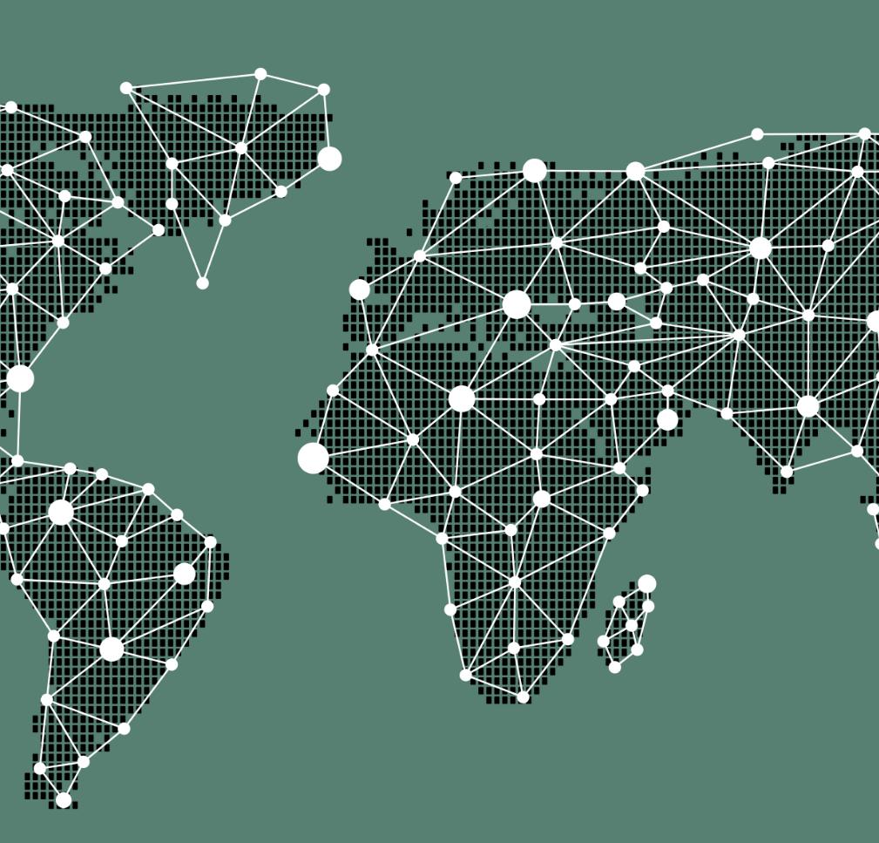
Problem & Opportunity
Global Internet Access Gap
  Approximately 2.6 billion people lack internet access, affecting economic and social development worldwide.
Impact of Broadband Expansion
  Broadband expansion positively influences economic growth, poverty reduction, and improved social mobility.
Low Earth Orbit (LEO) Satellite Networks
  Emerging LEO satellite constellations aim to provide high-speed global broadband, bridging connectivity gaps.
Role of Data Engineering
  Data engineering integrates diverse datasets to identify regions benefiting most from satellite broadband deployment.
Notes:
---
This slide references information from the following file: https://netorgft13171398-my.sharepoint.com/personal/gregsullivan_ciosoglobal_com/_layouts/15/Doc.aspx?sourcedoc=%7BFE73C346-6C18-4B53-A9D7-15C44C6565D9%7D&file=G%20Sullivan%205035%20Final%20Project%20Proposal.docx&action=default&mobileredirect=true
Nearly one-third of the global population—approximately 2.6 billion people—still lacks access to the internet, a resource that has become fundamental to economic development, social mobility, and human wellbeing. This slide explores the compelling relationship between connectivity and human development, emphasizing research that shows broadband expansion has a measurable positive effect on economic growth and poverty reduction. Furthermore, it introduces the emerging promise of Low Earth Orbit (LEO) satellite constellations such as Starlink, OneWeb, and Kuiper, which aim to deliver high‑speed global broadband coverage at scale. The significance of this opportunity lies in the role data engineering plays in integrating heterogeneous international datasets to quantify where satellite deployment can generate the greatest human impact. This framing sets the stage for the project’s research question: identifying regions where satellite broadband can meaningfully improve health, education, and income outcomes.

Slide 4
Context & Motivation
Notes:
---
This slide references information from the following file: https://netorgft13171398-my.sharepoint.com/personal/gregsullivan_ciosoglobal_com/_layouts/15/Doc.aspx?sourcedoc=%7BFE73C346-6C18-4B53-A9D7-15C44C6565D9%7D&file=G%20Sullivan%205035%20Final%20Project%20Proposal.docx&action=default&mobileredirect=true
Personal Context

Slide 5

Personal Context
Real-world Experience
  Project is inspired by my role as CIO at Carnival Corporation dealing with satellite connectivity challenges.
Human Impact of Connectivity
  Limited connectivity restricts education, wellbeing, financial services, and quality of life for guests and crew.
Global Digital Divide
  Connectivity gaps in remote regions highlight the need for satellite broadband to bridge digital divides globally.
Notes:
---
This slide references information from the following file: https://netorgft13171398-my.sharepoint.com/personal/gregsullivan_ciosoglobal_com/_layouts/15/Doc.aspx?sourcedoc=%7BFE73C346-6C18-4B53-A9D7-15C44C6565D9%7D&file=G%20Sullivan%205035%20Final%20Project%20Proposal.docx&action=default&mobileredirect=true
The personal motivation for this project is rooted in the presenter’s real‑world experience as Chief Information Officer at Carnival Corporation, where satellite connectivity directly affected guests, crew members, and remote operations. This context adds a powerful human dimension to the project by illustrating how limited connectivity restricts access to education, emotional wellbeing, financial services, and overall quality of life. Examples include crew unable to contact families for months or guests unable to manage travel logistics. These experiences demonstrated that connectivity gaps have tangible human consequences, particularly in remote regions such as Alaska or developing coastal countries. This narrative underscores why the analysis is not purely academic—rather, it is an exploration of a problem with significant human implications. Understanding this personal context strengthens the rationale for investigating satellite broadband as a tool for bridging global digital divides and improving everyday lives.

Slide 6
Preliminary Insights
Notes:
---
This slide references information from the following file: https://netorgft13171398-my.sharepoint.com/personal/gregsullivan_ciosoglobal_com/_layouts/15/Doc.aspx?sourcedoc=%7BFE73C346-6C18-4B53-A9D7-15C44C6565D9%7D&file=G%20Sullivan%205035%20Final%20Project%20Proposal.docx&action=default&mobileredirect=true
Preliminary Findings

Slide 7
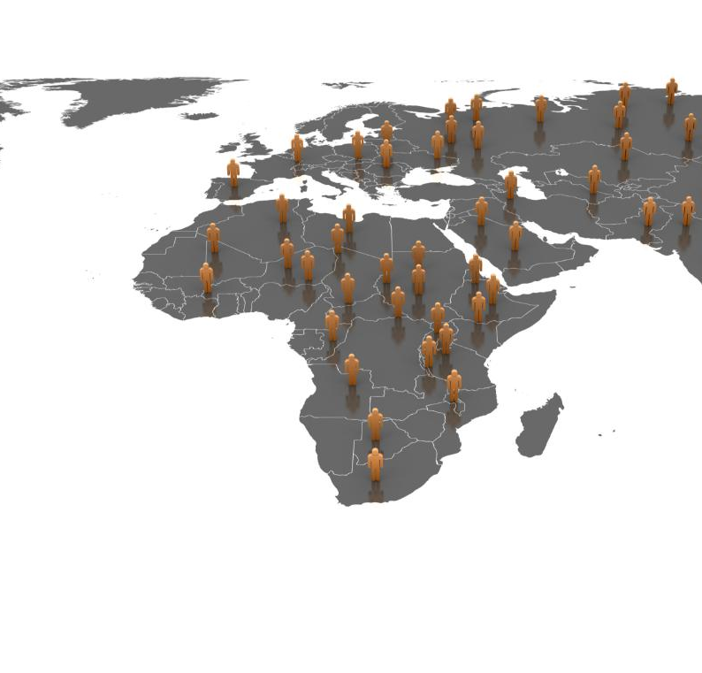
Preliminary Findings
Connectivity and Development Link
  Preliminary analysis shows a strong link between internet connectivity and human development outcomes worldwide.
High-Impact Opportunity Zone
  Seventeen countries with under 30% internet access and low Human Development Index (HDI) present high-impact broadband expansion opportunities.
Potential of Satellite Broadband
  Satellite broadband technology could transform underserved nations by improving education, health, and income.
Notes:
---
This slide references information from the following file: https://netorgft13171398-my.sharepoint.com/personal/gregsullivan_ciosoglobal_com/_layouts/15/Doc.aspx?sourcedoc=%7BFE73C346-6C18-4B53-A9D7-15C44C6565D9%7D&file=G%20Sullivan%205035%20Final%20Project%20Proposal.docx&action=default&mobileredirect=true
Early exploratory analysis conducted before the full project implementation revealed a strong empirical relationship between internet connectivity levels and human development outcomes. By aligning World Bank connectivity indicators with the Human Development Index (HDI) published by the UNDP, the preliminary study identified 17 countries where fewer than 30% of the population has internet access and HDI scores fall below 0.55. This set of countries represents a high‑impact opportunity zone where expanding broadband could generate the greatest improvement in education, health, and income. Notably, no countries exhibited the combination of high connectivity and low HDI, reinforcing the hypothesis that internet access and development are tightly coupled. This insight demonstrates both feasibility and direction for deeper analysis, suggesting that satellite broadband could be particularly transformative in these underserved nations.

Slide 8
Data Architecture
Notes:
---
This slide references information from the following file: https://netorgft13171398-my.sharepoint.com/personal/gregsullivan_ciosoglobal_com/_layouts/15/Doc.aspx?sourcedoc=%7BFE73C346-6C18-4B53-A9D7-15C44C6565D9%7D&file=G%20Sullivan%205035%20Final%20Project%20Proposal.docx&action=default&mobileredirect=true
Data Sources

Slide 9

Possible Data Sources
World Bank Development Indicators
  Provides decade-long country-level metrics on connectivity and economic development.
UNDP Human Development Index
  Offers composite measures covering education, health, and income for development analysis.
CelesTrak Orbital Data
  Supplies real-time satellite orbital data for geographic coverage and constellation modeling.
UCS Satellite Database
  Details satellite operator ownership and purpose to analyze deployment and competition.
Notes:
---
This slide references information from the following file: https://netorgft13171398-my.sharepoint.com/personal/gregsullivan_ciosoglobal_com/_layouts/15/Doc.aspx?sourcedoc=%7BFE73C346-6C18-4B53-A9D7-15C44C6565D9%7D&file=G%20Sullivan%205035%20Final%20Project%20Proposal.docx&action=default&mobileredirect=true
The project leverages four primary datasets, each contributing unique analytical value. World Bank Development Indicators provide a decade of connectivity and economic metrics across countries. The UNDP Human Development Index adds a composite measure of education, health, and income. CelesTrak supplies real‑time orbital element data that enables geographic coverage modeling for satellite constellations. The Union of Concerned Scientists (UCS) Satellite Database offers details on operator ownership and satellite purpose for understanding competitive and deployment contexts. Together, these sources require careful integration due to differing formats, update frequencies, and naming conventions. Their combined strength supports comprehensive multi‑dimensional analytics, enabling assessment of where connectivity gaps align with development need and satellite reach.

Slide 10
Analytical Framework
Notes:
---
This slide references information from the following file: https://netorgft13171398-my.sharepoint.com/personal/gregsullivan_ciosoglobal_com/_layouts/15/Doc.aspx?sourcedoc=%7BFE73C346-6C18-4B53-A9D7-15C44C6565D9%7D&file=G%20Sullivan%205035%20Final%20Project%20Proposal.docx&action=default&mobileredirect=true
Proposed Analytics

Slide 11

Proposed Analytics
Coverage Gap Analysis
  Analyzes LEO satellite orbital constraints against national boundaries to identify underserved areas within coverage bands.
Constellation Comparison
  Compares satellite constellations by count, inclination, and geographic reach among major operators.
Trend Analysis
  Uses a decade of World Bank data to assess if countries are improving connectivity or remain stalled.
Affordability Modeling & Impact Scoring
  Quantifies economic accessibility and integrates multiple factors to rank countries by satellite internet benefit.
Notes:
---
This slide references information from the following file: https://netorgft13171398-my.sharepoint.com/personal/gregsullivan_ciosoglobal_com/_layouts/15/Doc.aspx?sourcedoc=%7BFE73C346-6C18-4B53-A9D7-15C44C6565D9%7D&file=G%20Sullivan%205035%20Final%20Project%20Proposal.docx&action=default&mobileredirect=true
The proposed analytical workstream includes several complementary components designed to answer where satellite broadband can create the highest impact. Coverage gap analysis overlays LEO satellite orbital constraints with national boundaries to determine whether underserved countries fall within viable coverage bands. Constellation comparisons examine differences between major operators—including Starlink and OneWeb—in terms of satellite count, inclination, and potential geographic reach. Trend analysis uses ten years of World Bank data to determine whether countries are improving connectivity independently or remain stalled. Affordability modeling quantifies economic thresholds at which satellite internet becomes accessible to populations. Finally, a multi‑factor impact scoring model integrates all dimensions—connectivity gaps, HDI need, satellite coverage, and affordability—to rank countries based on potential benefit. This framework ensures the final output is actionable, evidence‑based, and scalable.

Slide 12
Execution Strategy
Notes:
---
This slide references information from the following file: https://netorgft13171398-my.sharepoint.com/personal/gregsullivan_ciosoglobal_com/_layouts/15/Doc.aspx?sourcedoc=%7BFE73C346-6C18-4B53-A9D7-15C44C6565D9%7D&file=G%20Sullivan%205035%20Final%20Project%20Proposal.docx&action=default&mobileredirect=true
Challenges & Mitigation

Slide 13

Challenges & Mitigation
Entity Resolution Challenges
  Different country naming conventions require fuzzy matching or standardized crosswalks for data alignment.
Data Currency Constraints
  Satellite data update frequencies vary, causing possible discrepancies between data sources like UCS and CelesTrak.
Modeling Coverage Zones
  Simplifying orbital mechanics into latitude-based zones requires careful documentation and validation.
Risk Mitigation Strategy
  Tiered scope and transparent assumptions maintain project momentum and analytical rigor.
Notes:
---
This slide references information from the following file: https://netorgft13171398-my.sharepoint.com/personal/gregsullivan_ciosoglobal_com/_layouts/15/Doc.aspx?sourcedoc=%7BFE73C346-6C18-4B53-A9D7-15C44C6565D9%7D&file=G%20Sullivan%205035%20Final%20Project%20Proposal.docx&action=default&mobileredirect=true
Executing this project requires resolving several data engineering challenges. Entity resolution is necessary because country names do not align across datasets, requiring fuzzy matching or standardized crosswalks. Data currency poses another constraint, as satellite data updates at varying frequencies, potentially leading to discrepancies such as mismatches between UCS and CelesTrak satellite counts. Modeling satellite coverage zones involves simplifying orbital mechanics into latitude‑based approximation bands, which must be documented and validated. Temporal alignment is also essential, as World Bank indicators vary in completeness across years, while HDI and satellite data represent snapshots. Risk mitigation includes a tiered scope structure ensuring essential deliverables are completed first, simplifying complex modeling where feasible, and documenting assumptions transparently. This strategy ensures project momentum while maintaining analytical rigor.

Slide 14
Outcome Impact
Notes:
---
This slide references information from the following file: https://netorgft13171398-my.sharepoint.com/personal/gregsullivan_ciosoglobal_com/_layouts/15/Doc.aspx?sourcedoc=%7BFE73C346-6C18-4B53-A9D7-15C44C6565D9%7D&file=G%20Sullivan%205035%20Final%20Project%20Proposal.docx&action=default&mobileredirect=true
Expected Deliverables

Slide 15
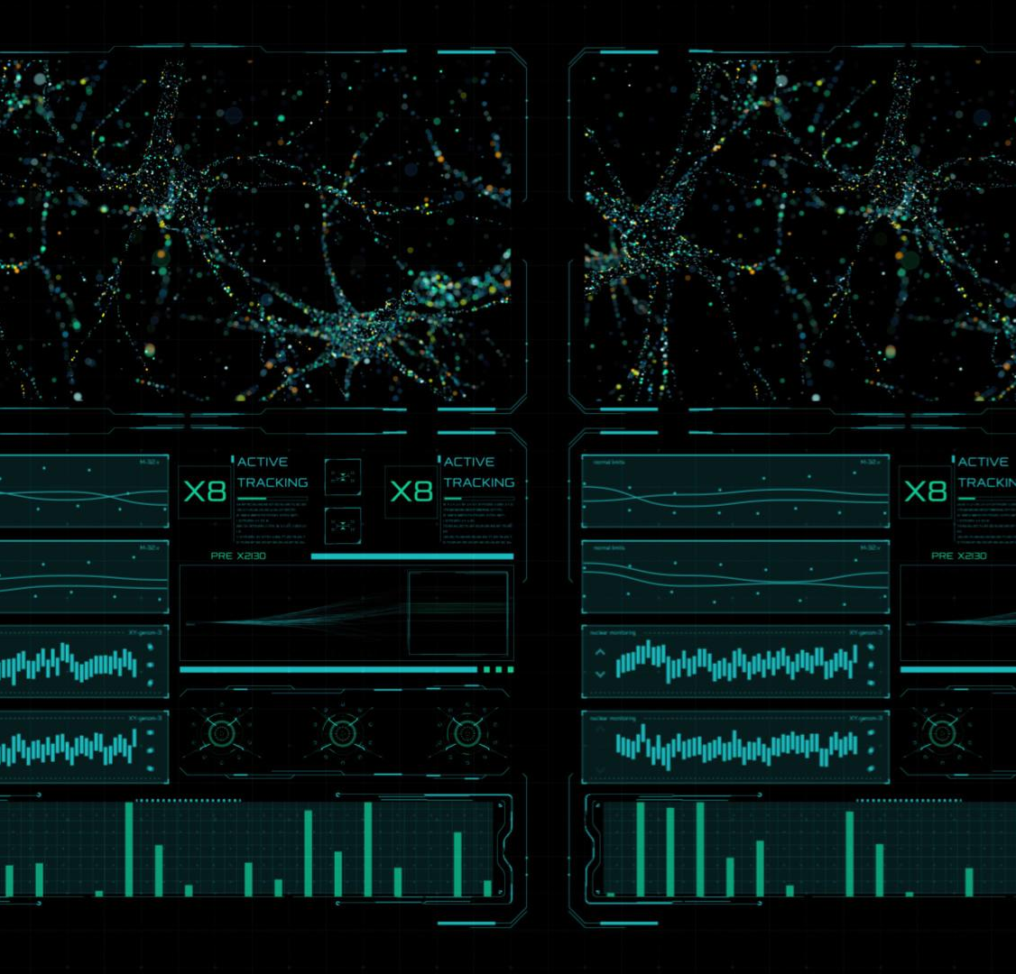
Expected Deliverables
Integrated Data Set
  A validated dataset links connectivity, human development, and satellite coverage per country for comprehensive analysis.
Impact Scoring Model
  Models identify areas where LEO satellites can maximize social uplift and improve connectivity.
Interactive Visualizations
  Dashboards and geographic animations enable stakeholders to explore global connectivity patterns interactively. Tools may be Python, Tableau or Flourish, as examples.
Technical Documentation
  Comprehensive documentation ensures reproducibility of ETL pipelines and data quality frameworks.
Notes:
---
This slide references information from the following file: https://netorgft13171398-my.sharepoint.com/personal/gregsullivan_ciosoglobal_com/_layouts/15/Doc.aspx?sourcedoc=%7BFE73C346-6C18-4B53-A9D7-15C44C6565D9%7D&file=G%20Sullivan%205035%20Final%20Project%20Proposal.docx&action=default&mobileredirect=true
The final project deliverables are designed to communicate both the analytical rigor and the human significance of the findings. Core outputs include an integrated, validated dataset linking connectivity, human development, and satellite coverage for every country. The impact scoring model will identify where LEO satellite networks could drive the greatest social uplift. Visual components such as interactive Tableau dashboards and geographic animations will help stakeholders explore global patterns and opportunities. Case studies, including high‑latitude examples like Alaska or remote regions visited by cruise vessels, will ground the analysis in real‑world narratives. Technical documentation will ensure reproducibility across ETL pipelines, data quality frameworks, and modeling procedures. Taken together, these deliverables form a persuasive, data‑driven story about how satellite broadband can bridge global inequality gaps.

